Slide 1
Software Verification
An Introduction to Code Reviews and Testing

Slide 2
Review
Validation:
The process of determining if a product (or its specification) satisfies stakeholders’ needs and desires ("Are we building the right product?")
Verification:
The process of determining if a product (or its specification) satisfies those needs and desires properly ("Are we building the product right?")

Slide 3
Terminology
// An example in pseudocode
a = getNextInt();
b = getNextInt();
c = a/b;
print(c);
Defect:
Any undesirable aspect of a product
Failure:
A deviation between a product’s actual behavior and intended behavior (e.g., a feature that is missing or incorrect)
Fault:
A defect that could (or does) give rise to a failure
Trigger Condition:
A condition that cause a fault to result in a failure
Symptom:
A characteristic of a failure (that helps you recognize that a failure has occurred)

Slide 4
Terminology (cont.)
// An example in pseudocode
a = getNextInt();
b = getNextInt();
c = a/b;
print(c);
Trigger Condition?
Failure?
Symptom?
Fault?

Slide 5
Terminology (cont.)
// An example in pseudocode
a = getNextInt();
b = getNextInt();
c = a/b;
print(c);
Trigger Condition?
b having the value 0
Failure?
The program does not produce the correct output
Symptom?
Depending on the language, the symptom might be termination (e.g., because of a divide by 0 exception) or an infinite/undefined/NaN value in c
Fault?
Not checking the value of b and not providing a default value for b or c

Slide 6
Terminology (cont.)
A Missing Term:
"Bug"
Why Is It Omitted?
People do not use the term "bug" consistently
Implications:
We will use the term "debugging" but will not use the term "bug" (except casually)

Slide 7
Types of Faults
Algorithmic: A block of code does not generate the proper output for a given input
Precision: The computation is not performed to the desired accuracy
Checking: The inputs are not validated before the computation is performed
Stress/Overload: The problem occurs when data structures are filled past their capacity
Assignment: Fault in variable/data structure initialization

Slide 8
Types of Faults (cont.)
Throughput/Performance: A block of code does not perform at the required speed
Timing/Coordination: Involves shared resources
Recovery: A block of code does not respond to another fault appropriately

Slide 9
Code Reviews
Desk Checking:
The programmer reads through the program (and traces the execution) herself/himself
Code Walkthrough:
The programmer gives her/his code to a review team and leads an (informal) discussion
Code Inspection:
A review team checks the code against a prepared list of concerns

Slide 10
Development/Construction Testing - The Stages
Unit Testing (or Module/Component Testing):
A component is tested on its own (in isolation from any other components)
Integration Testing:
Components are tested in combination
System Testing:
The product is tested in its entirety, that is, all of the components that comprise the (current increment of the) product are tested in combination

Slide 11
Development/Construction Testing - The Participants
Unit Testing (or Module/Component Testing):
Typically must be performed by "programmers"
Integration Testing:
Typically must be performed by "programmers"
System Testing:
Can be performed "testers" (either in-house or potential users)

Slide 12
Testing - Terminology
Test/Test Case/Test Point:
A particular choice of inputs (and expected output)
Test Suite:
A collection of tests
Follow-Up Test:
A test that is created after another test reveals a symptom/failure (used to determine if a fault is more serious than it appears and/or more general than it appears)

Slide 13
Testing - Approaches
Black Box (or Closed Box):
The tester has information about the form of the inputs and the outputs, but not about the "internals" of the component being tested
State Box:
The tester has information about the "pre" state and "post" state, as well as the form of the inputs and outputs
White Box (or Clear/Open Box):
The tester knows the internal details of the component being tested

Slide 14
Testing - Black-Box Unit Testing
A Popular Approach:
Supply the unit with all possible inputs
Some Realities:
The number of test cases can be very large!
How do you check the results?
The state may matter (hence the sequence of test cases may matter as may things in the broader system)

Slide 15
Testing - Black-Box Unit Testing (cont.)
Random Testing:
Generate test cases randomly
Heuristic Testing:
Generate test cases using "rules of thumb" (e.g., boundary value analysis)

Slide 16
Testing - Black-Box Unit Testing (cont.)
Value Heuristics:
Extreme values are thought to be the most likely to cause a failure (e.g., include a test case with a large positive value, a small positive value, 0, a large negative number, a small negative number)
Include type mismatches (e.g., characters for integers)
Array Heuristics:
Include a small array, large array, 0-length array, 1-length array
Include unsorted, sorted ascending, and sorted descending arrays
Include arrays with one value (e.g., all negative, all positive, all 0)

Slide 17
Testing - Black-Box Unit Testing (cont.)
File Name Heuristics:
Include multiple files with the same prefix.
Include multiple files with the same suffix (i.e., file type).
Include files that reverse the prefix and suffix.
String Heuristics:
Include strings that vary only in case (e.g., all upper case, all lower case, mixed case)
Include zero-length strings
Include long strings
Include short strings
Include strings that consist of one repeated character
Include strings that are in reverse order
Include strings that swap underscores and dashes
Include strings that swap ones and lower case ls
Include strings that swap zeros and Os

Slide 18
Testing - Equivalence Classes
Definition:
A set of test cases in which each element triggers the same failure
Importance:
If one can identify an equivalence class then there is no reason to include more than one test from the set

Slide 19
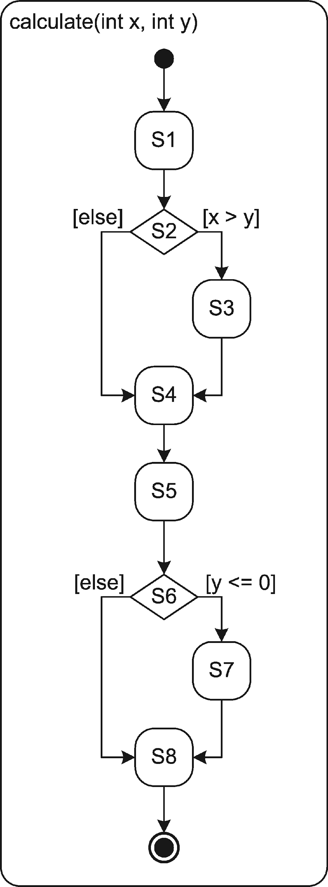
Testing - Clear-Box Unit Testing
// An example in pseudocode
int calculate(int x, int y) {
int a, b;
a = 1; // S1
if (x > y) // S2
a = 2; // S3
x++; // S4
b = y * a; // S5
if (y <= 0) // S6
b++; // S7
return b; // S8
}
Statement Coverage:
Make sure every statement is executed
Branch (a.k.a., Decision) Coverage:
Make sure every "branch" (resulting from conditionals) is executed
Path Coverage:
Make sure every path through the code is executed
Notes:
Section 1, 2

Slide 20
Testing - Coverage (cont.)
// An example in pseudocode
int calculate(int x, int y) {
int a, b;
a = 1; // S1
if (x > y) // S2
a = 2; // S3
x++; // S4
b = y * a; // S5
if (y <= 0) // S6
b++; // S7
return b; // S8
}
Covering Every Statement:
calculate(5, -2)
(S1-S2-S3-S4-S5-S6-S7-S8)
Covering Every Branch (S3 and Not S3, S7 and Not S7):
calculate( 5, 2)
(S1-S2-S3-S4-S5-S6-S8)
calculate(-2, -1)
(S1-S2-S4-S5-S6-S7-S8)
Covering Every Path (S3 then Not S7, Not S3 then Not S7, S3 then S7, Not S3 then S7):
calculate( 5, 2)
(S1-S2-S3-S4-S5-S6-S8)
calculate(-2, 5)
(S1-S2-S4-S5-S6-S8)
calculate(-1,-2)
(S1-S2-S3-S4-S5-S6-S7-S8)
calculate(-2,-1)
(S1-S2-S4-S5-S6-S7-S8)

Slide 21
Testing - Clear-Box Unit Testing (cont.)
Condition Coverage:
Make sure both values in every Boolean expression (with N sub-expressions in a single conditional) is covered (i.e., in the worst case, there are 2∗N conditions)
if ((A || B) && C) {
<< Few Statements >> }
else {
<< Few Statements >> }
TEST CASE1: A = true | B = not eval. | C = false
TEST CASE2: A = false | B = true | C = true
TEST CASE3: A = false | B = false | C = not eval

Slide 22
Testing - Clear-Box Unit Testing (cont.)
Multiple Condition Coverage:
Make sure every (in the worst case, 2^{N}) possible combination of every Boolean expression (with N sub-expressions in a single conditional) is covered
if (A||B) then print C
TEST CASE1: A=TRUE, B=TRUE TEST CASE2: A=TRUE, B=FALSE TEST CASE3: A=FALSE, B=TRUE TEST CASE4: A=FALSE, B=FALSE

Slide 23
Testing - Counting Conditions
The Naive Approach:
Since each simple Boolean expression takes on two possible values it follows that compound expressions have two conditions for each simple expression
Example: (x > 0) && (y > 0) has 4 conditions
More Accurately:
There may be fewer conditions
Example: (x > 0) && (x < 100) really only has three conditions

Slide 24
Testing - A Mixture of Black-Box and Clear-Box Unit Testing
A Popular Approach:
Categorize the possible inputs into equivalence classes to reduce the number of tests
Some Realities:
This is often difficult to do!
How do you check the results?
The state may matter (hence the sequence of test cases may matter as may things in the broader system)
Notes:
Section 2

Slide 25
Testing - Integration Testing Strategies
Bottom Up:
Test all of the lowest level components first
Add components that use tested components
Top Down:
Test the top level component first (using stubs)
Add components called by the tested component(s)
Big Bang:
Test all components in isolation
Test the entire system

Slide 26
Testing - System Testing
Alpha Testing:
Scripted - the tester follows a well-defined set of steps (so that the test is repeatable) and records the failures
Open Ended - the tester uses the product in a "free form" fashion and records the failures
Beta Testing:
Open Ended - the user often reports her/his experiences using a bug-tracking system
Notes:
Section 5

Slide 27
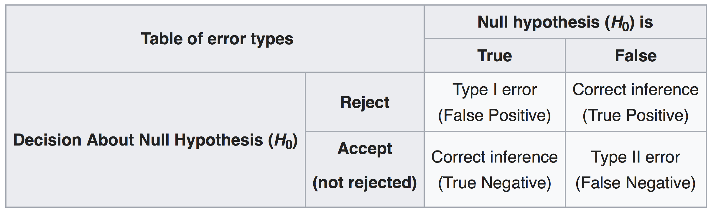
Testing - Checking the Outputs
An Observation:
Automated testing depends on our ability to detect failed tests automatically
A Solution:
Have an oracle (either an individual or another program) that knows the truth
Use a test harness/framework that makes it easy to compare actual and expected/correct values
A Complication:
An imperfect oracle can lead to both Type I and Type II errors
Notes:
Section 1

Slide 28
From Testing to Debugging
Output of a Failed Test:
A symptom and one of the trigger conditions that gives rise to the symptom
Debugging:
Using the trigger condition to identify and correct the fault

Slide 29
Getting to Debugging
Testing:
The output of a failed test is a symptom and one of the trigger conditions that gives rise to the symptom
Debugging:
Using the trigger condition to identify and correct the fault

Slide 30
The Debugging Process
Step 1: Stabilize - Understand the symptom and the trigger condition identified by the test so that the failure can be reproduced.
Step 2: Localize - Locate the fault.
Examine the sections of code that are likely to be influenced by the trigger condition.
Form a hypothesis about the fault.
Instrument the relevant sections of code.
Execute the code using the instrumentation.
Prove or disprove the hypothesis. If proven, go to step 3; otherwise go to step 2.
Step 3: Correct - Fix the fault.
Step 4: Verify - Test the fix and run regression tests.
Step 5: Globalize - Look for and fix similar defects in other parts of the system. Refactor if necessary.

Slide 31
Instrumentation Techniques
Using Debug Code:
Add temporary output statements that can be used to monitor state information
Add temporary input statements that can be used to pause the execution
Using a Debugger:
Use watches to monitor state information
Set breakpoints to pause the execution
Execute statements "one at a time" (e.g., step into, step over)

Slide 32
Outcomes of Debugging
What Can Happen?
Fault corrected and no new fault introduced
Fault corrected and new fault introduced
Fault not corrected and no new fault introduced
Fault not corrected and new fault introduced
Real World Data:
As many as 30% of changes result in one of the three bad outcomes
Bad outcomes occur on average 10% of the time
Faults introduced during debugging are more difficult to identify and remove
Implications:
Carefully test fixes
Re-run old tests after fixing
Regression Testing:
The process of re-running all existing tests

